Slide 1

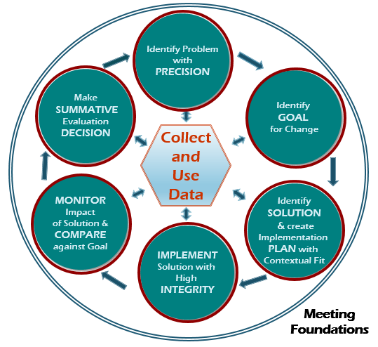

Team
Initiated
Problem
Solving TIPS II
CA PBIS Pre-Conference Workshop 2018
Horner, R. H., Newton, J. S., Todd, A. W., Algozzine, B.,
Algozzine, K., Cusumano, D. L., & Preston, A. I. (2015).
Cristy Clouse
Barbara Kelley
Notes:
Barb
Literature Review
A 2010 review documented 160+ publications
Effective teams use data to document progress and outcomes, guide decisions, and inform stakeholders (Boudett, City, & Murnane, 2006; Burke, 2010; Deno, 2005; Hill 2010; Newton, Algozzine, Algozzine, Horner, & Todd, 2011; Newton, Horner, Algozzine, Todd, & Algozzine, 2009; Pidgeon & Gregory, 2004; Renfro & Grieshaber, 2009)
A critical predictor of sustained implementation of SWPBIS (Coffey & Horner, 2012; McIntosh et al., 2013)
Fidelity and student outcome data are essential (Fixsen, Blase, Metz, & Van Dyke, 2013)
CRISTY: Objectives on Table Tent

Slide 2
Color:
(pick your green color)
is like
DATA BASED DECISION MAKING because
Notes:
Cristy

Slide 3

TFI 1.12
5 minute
Notes:
Barb

Slide 4


“Without good data and assessment reports, we are simply throwing the spaghetti at the wall, seeing what sticks, then trying something else.”
-Beth Baker and Char Ryan
Tiered Fidelity Inventory (TFI)
1.12: Discipline Data Tier I team has instantaneous access to graphed reports summarizing discipline data organized by the frequency of problem behavior events by behavior, location, time of day, and by individual student.
Is there a centralized data system to collect and organize behavior incident data? Does the Tier I team have instantaneous access to graphed reports summarizing discipline data? Are those data organized to review all of the following: frequency of problem behavior events by behavior, location, time of day and student?
Notes:
Barb

Slide 5
TFI 1.12
TFI 1.13
5 minute
Notes:
Cristy

Slide 6
“The greatest challenge to any thinker is stating the problem in a way that will allow a solution.”
-Bertrand Russel
Tiered Fidelity Inventory (TFI)
1.13: Data-based Decision Making Tier I team reviews and uses discipline data and academic outcome data (e.g., Curriculum-Based Measures, state tests) at least monthly for decision making.
Does the team have access to discipline data for the entire student body (school-wide)? Does the team have access to academic data for the entire student body? Are those data clearly and logically linked to the annual action plan for Tier I? Are those data reviewed at least monthly?
Notes:
Cristy

Slide 7
TFI 1.12
Readiness Checklist
5 minutes
TFI 1.13
Notes:
Barb

Slide 8
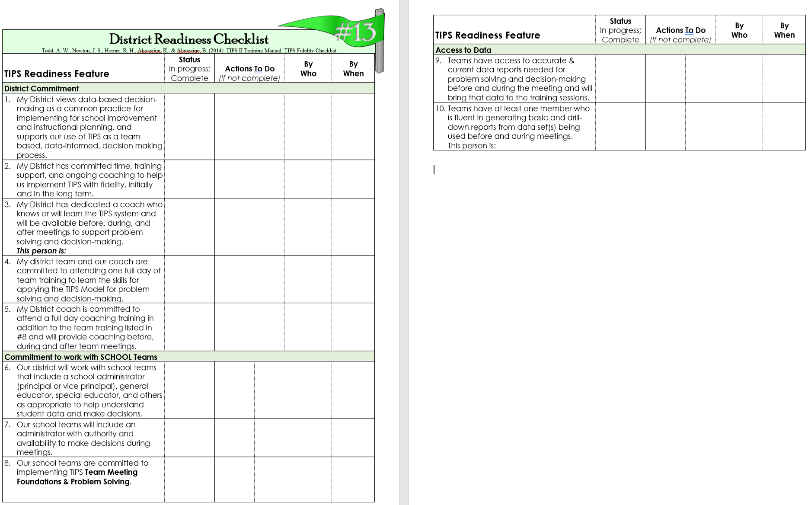
DATA Acronym
Notes:
Barb

Slide 9
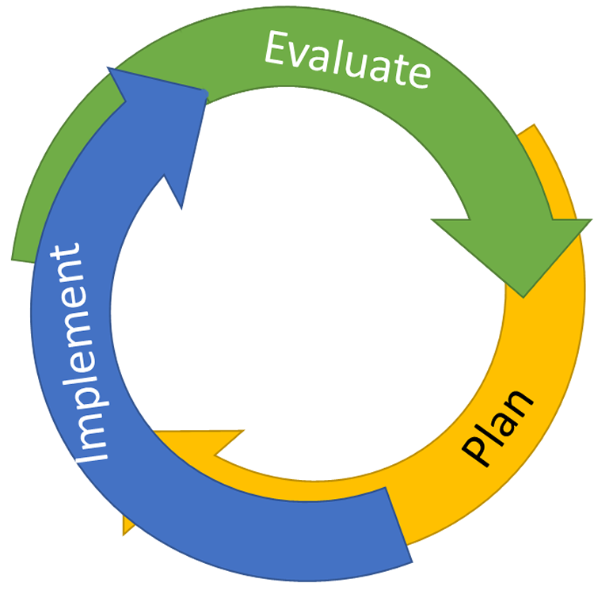
Continuous Quality Improvement
Data Collection and Organization
Defining the Problem with Precision
Cycle of Continuous Improvement
Action Plan Implementation
Goal Identification
Solution Development
Action Planning
Notes:
BARB
Using data for decision-making is key to using the collaborative learning cycle, which results in effective, efficient and effective action planning and implementation. Data (observations, facts or numbers), when collected and organized, become information and knowledge. Data alone are merely numbers or words and have no intrinsic meaning. Individuals or groups give meaning to data by organizing, analyzing, interpreting and using them. Problem solving teams define questions, leading to solutions by identifying and refining problems. The problem is placed in the context, not the student.

Slide 10


A + B = C
Adult Behaviors equal student Change
Outcome
Fidelity
DATA
We made impact!
We got results!
We worked the plan the way it was designed.
We gave it our best effort!
Notes:
BARB
Remember that we always want to look at the fidelity of our systems and practices as well as the impact on student behavior or performance.

Slide 11
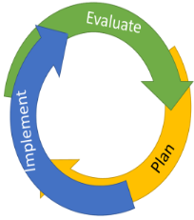
Connecting
Outcomes & Fidelity
Lucky | Sustaining
Positive outcomes, low understanding of how they were achieved Replication of success is unlikely | Positive outcomes, high understanding of how they were achieved Replication of success likely
Losing Ground | Learning
Undesired outcomes, low understanding of how they were achieved Replication of failure likely | Undesired outcomes, high understanding of how they were achieved Replication of mistakes unlikely
Outcomes
Fidelity
Notes:
BARB

Slide 12
What, Who, When, Where, and Why?
Identify Problem
with
Precision
Team Initiated Problem Solving Model
How do we want the problem to change?
What next?
Make Summative
Evaluation
Decision
Identify
Goal for Change
Collect and Use Data
Has the problem been solved?
Monitor Impact
of Solution and
Compare
against Goal
Identify
Solution and
Create
Implementation
Plan with
Contextual Fit
Implement
Solution with
High Integrity
Horner, R. H., Newton, J. S., Todd, A. W., Algozzine, B.,
Algozzine, K., Cusumano, D. L., & Preston, A. I. (2015).
What are we going to do to bring about desired change?
Did we implement with fidelity?
Meeting
Foundations
Notes:
Cristy

Slide 13
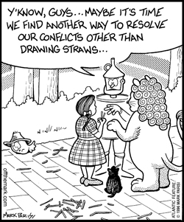
Meeting Foundations
People aren’t tired from solving problems…
they are tired from solving the same problem over and over.
Notes:
Cristy

Slide 14
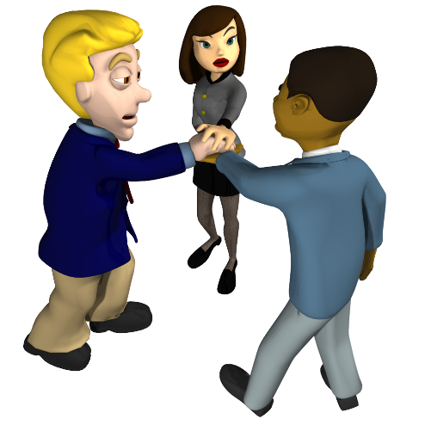
Meeting Foundations
Meeting schedule is created
Members attend meetings
Projected agenda is reviewed and followed
Team roles/responsibilities are clearly defined
Solutions identified by team can be approved for implementation during the meeting
Notes:
Cristy

Slide 15

#1
Give the meeting a purpose.
Name and Train a Data Analyst
Administrators Get to Wear Their Administrator Hat
Backups, Backups, Backups
Get Precise
Meeting Foundations
TOP
5 TIPS
Which tip will be the EASIEST/HARDIEST for your team?
Notes:
Cristy

Slide 16
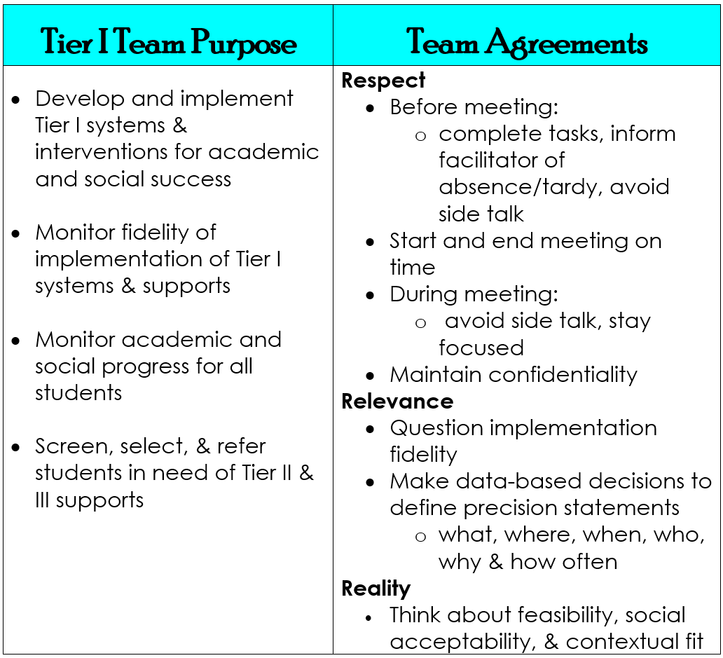
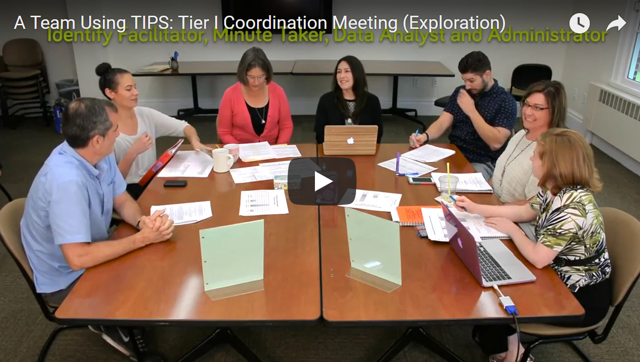
Meeting Foundations
https://www.youtube.com/watch?time_continue=554&v=5CH5Ca5hDmc
Notes:
Cristy
This video provides an example of a Tier I or Universal Leadership Team using the Team Initiated Problem Solving (TIPS) Model to develop and implement Tier I systems and interventions for academic and social success; monitor fidelity of implementation of Tier I systems and supports; monitor academic and social progress for all students; and screen, select, and refer students in need of additional supports.

Slide 17
Fidelity Checklist
#2
Team Meeting Foundations | Current Status? | What are the next steps?
1. Primary and backup individuals are assigned to defined roles and responsibilities of Facilitator, Minute Taker, and Data Analyst.
2. Meeting participants have the authority to develop and implement problem-solving solutions.
3. Meeting started on time.
4. Meeting ended on time, or members agreed to extend meeting time.
5. Team members attend meetings promptly and regularly.
6. Public agenda format was used to define topics and guide meeting discussion and was available for all participants to refer to during the meeting.
7. Previous meeting minutes were present and reviewed at start of the meeting.
8. Next meeting was scheduled by the conclusion of the meeting.
9. Meeting Minutes are distributed to all team members within 24 hours of the conclusion of the meeting.
Notes:
Cristy
measures implementation status of meeting foundations.

Slide 18
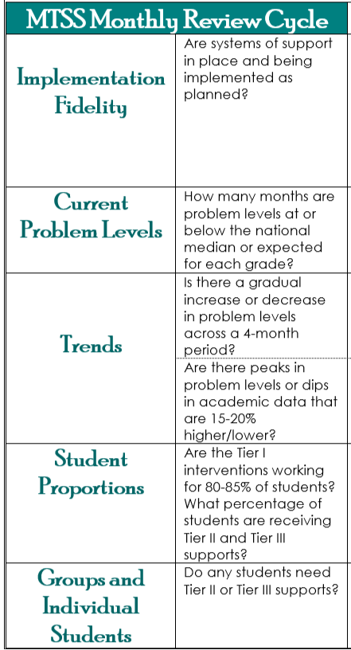
BEHAVIOR | ACADEMIC
#3
Team Decision Guidelines
Notes:
Barb

Slide 19
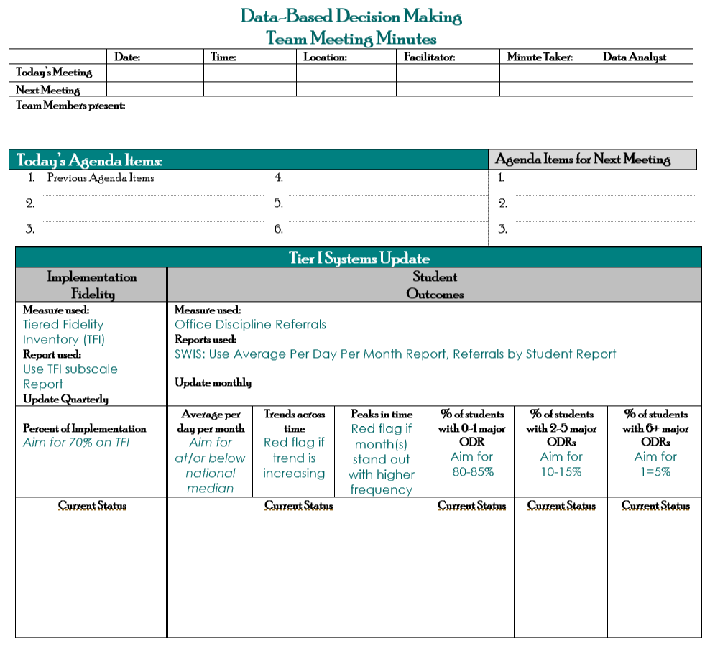
Team Meeting Minutes
#4
Notes:
Barb

Slide 20
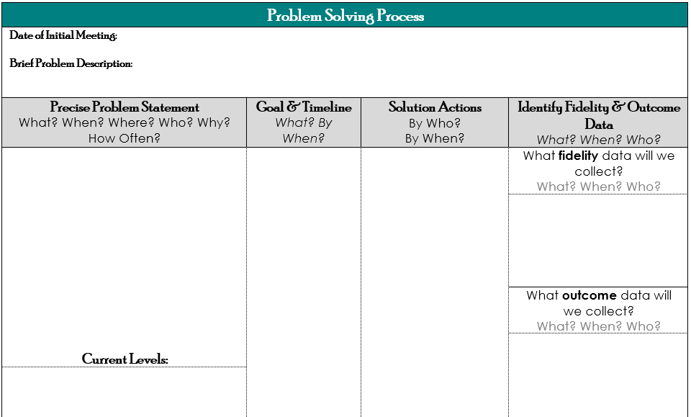
Team Meeting Minutes
#4
Notes:
Barb

Slide 21
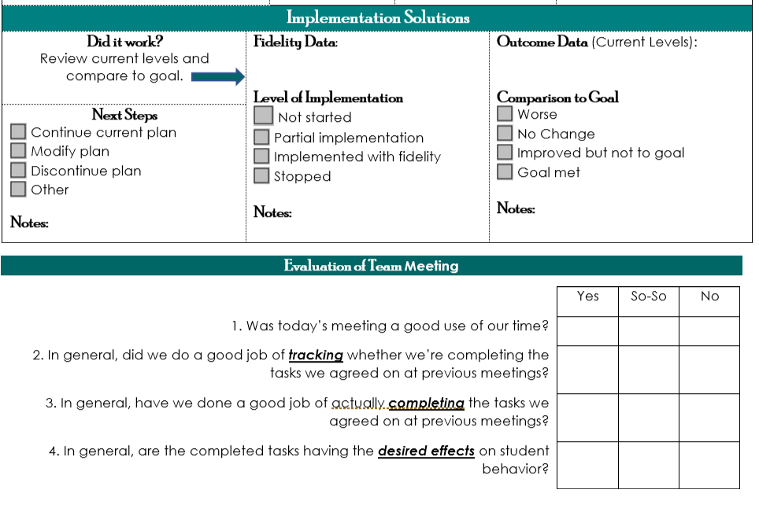
Team Meeting Minutes
#4
Notes:
BARB

Slide 22
Fidelity Checklist
#5
Problem Solving | Score
10. Team uses TIPS Meeting Minutes form or equivalent*.
11. Status of all previous solutions was reviewed.
12. Quantitative data were available and reviewed.
13. At least one problem is defined with precision (what, where, when, by whom, why).
14. All documented active problems have documented solutions.
15. Full action plan (who, what, when) is documented for at least one documented solution.
16. Problems that have solutions defined have a goal defined.
17. A fidelity of implementation measure is documented for each solution, along with a schedule for gathering those data.
Notes:
CRISTY

Slide 23
What, Who, When, Where, and Why?
Identify Problem
with
Precision
Team Initiated Problem Solving Model
Make Summative
Evaluation
Decision
Identify
Goal for Change
Collect and Use Data
Monitor Impact
of Solution and
Compare
against Goal
Identify
Solution and
Create
Implementation
Plan with
Contextual Fit
Implement
Solution with
High Integrity
Horner, R. H., Newton, J. S., Todd, A. W., Algozzine, B.,
Algozzine, K., Cusumano, D. L., & Preston, A. I. (2015).
Meeting
Foundations
Notes:
BARB

Slide 24

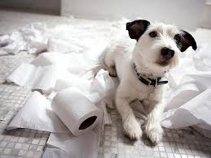
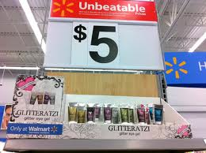


Defining a Problem with Precision
What is a problem?
Notes:
BARB

Slide 25
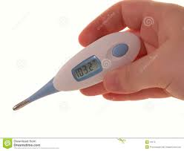
Defining a Problem with Precision
What?
different problems that will need
different solutions
103.2
When?
Why?
Where?
Who?
Notes:
BARB

Slide 26
Primary
The boys in third grade are having behavior problems.
A large group of sixth graders are displaying inappropriate behaviors in the Commons. This cohort of students also is known to reside in less than positive neighborhoods many of which also come from households with older siblings who have been in an out of jail across the past years. Drugs, alcohol, and violent behavior are the norm on the streets around their homes.
Primary
Six 5th grade students are loitering in the halls in the morning and have accumulated more than 10 referrals for loitering and being tardy during the past month. It is believed that they are doing this in order to avoid homework reviews that take place in the class during that time.
Precise
Notes:
BARB

Slide 27

Red Flag: What?
#6
Defiance
Notes:
.BARB

Slide 28
Where?
Classroom
Playground
Notes:
BARB

Slide 29
When?
11:45-12:00
Notes:
BARB

Slide 30
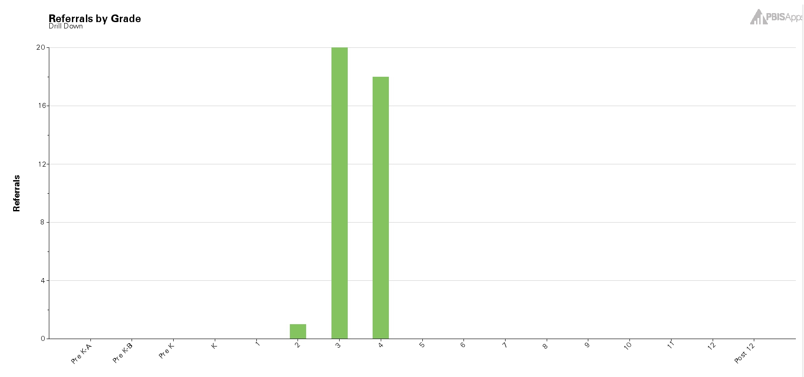
Who?
3rd and 4th Grade
Notes:
BARB

Slide 31
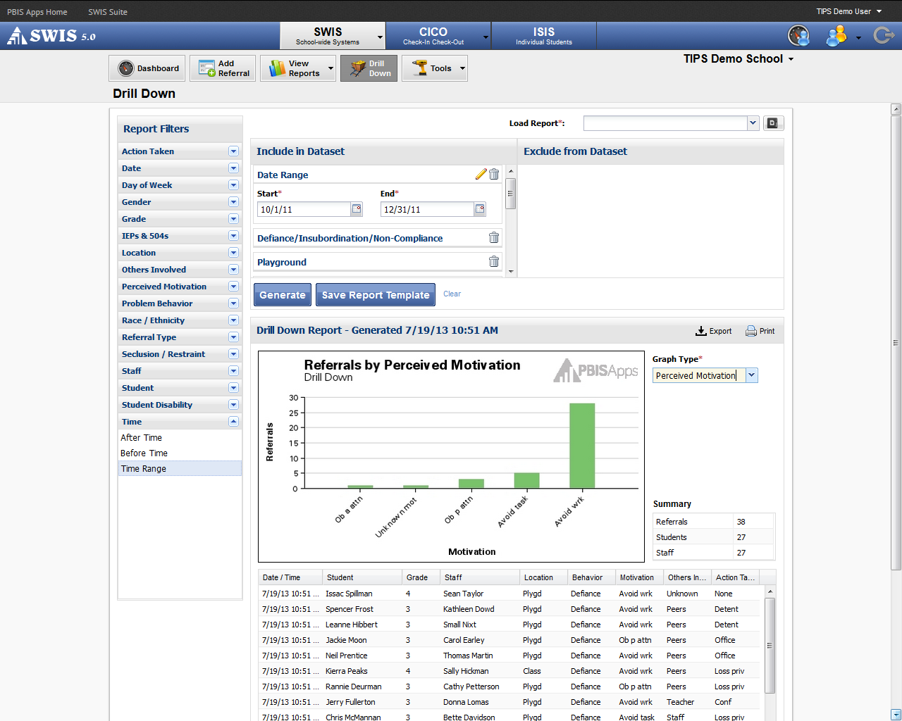
Why?
Avoid Work
Notes:
BARB

Slide 32
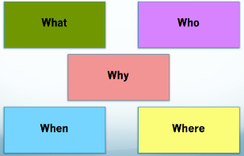
Moving from Primary to Precise
#6
  What problem behaviors are most common?
    Referrals by Problem Behavior
  Where are problem behaviors most likely?
    Referrals by Location
  When are problem behaviors most likely?
    Referrals by Time
  Who is engaged in problem behavior?
    Referrals by Student
  Why are problem behaviors sustaining?
    Data Drill Down
  PROBLEM PRECISION STATEMENT
Notes:
.BARB

Slide 33
#6
  Many 3rd and 4th graders (who) are engaging in Defiance (what) between 11:45 and 12:00, near the end of their 30-minute recess period (when), with most of these instances occurring on the playground and in class (where), because the students want to avoid the upcoming classroom instructional period (why).
  Nov. = .73/ day,
  Dec. = 1.5/day
  Jan. = .42 /day
Notes:
BARB

Slide 34
Identify Problem
with
Precision
Team Initiated Problem Solving Model
How do we want the problem to change?
Make Summative
Evaluation
Decision
Identify
Goal for Change
Collect and Use Data
Monitor Impact
of Solution and
Compare
against Goal
Identify
Solution and
Create
Implementation
Plan with
Contextual Fit
Implement
Solution with
High Integrity
Horner, R. H., Newton, J. S., Todd, A. W., Algozzine, B.,
Algozzine, K., Cusumano, D. L., & Preston, A. I. (2015).
Meeting
Foundations
Notes:
CRISTY

Slide 35
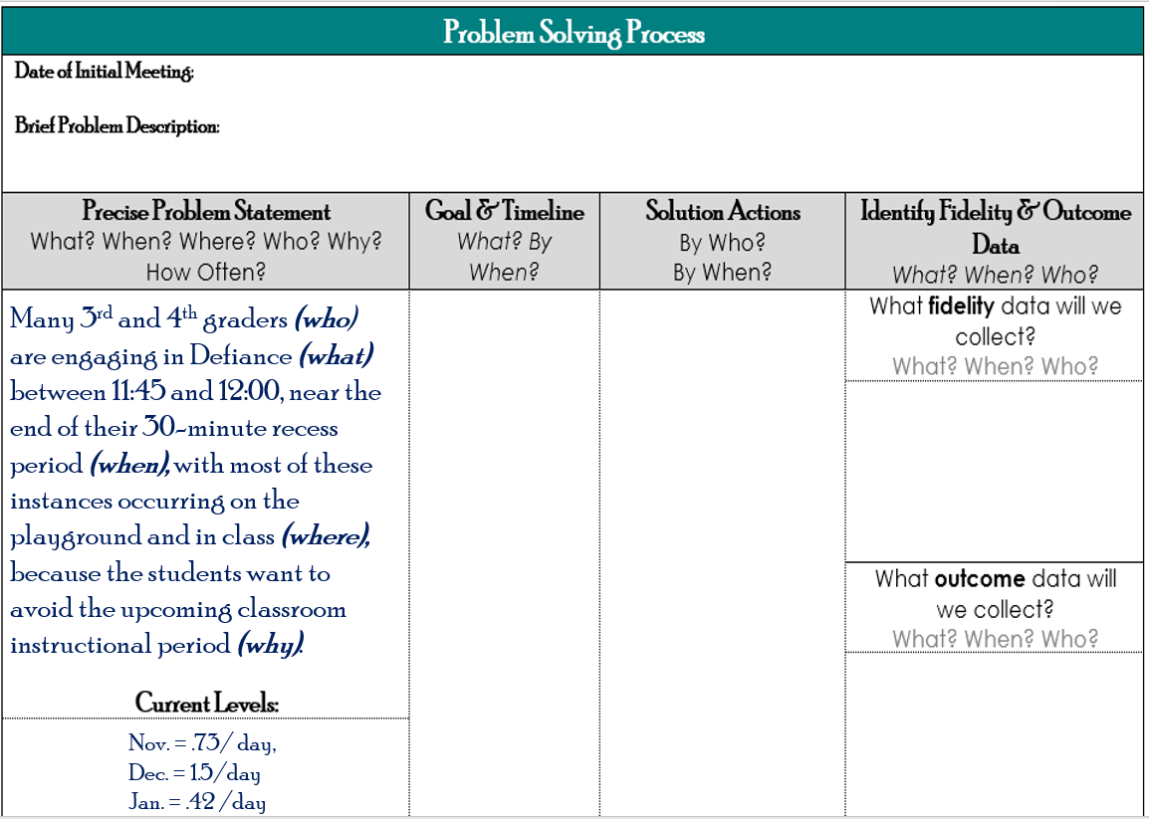
SMART Goals
#7
“If we can define it, we can measure it. If we can measure it we can grow”.
    Specific
    Measurable
    Achievable
    Relevant
    Timely
Notes:
CRISTY

Slide 36
Building Goals
Problem | Level | Goal
Many students are leaving garbage in the cafeteria resulting in conflict and ODRs. The behavior is maintained because students are rushing to get to the common area for social time. | 22 ODRs per month from the cafeteria Heidi (café supervisor) rates cafeteria as “1” (low) on a 1-5 scale of cleanliness. | Less than 5 ODRs per month from the cafeteria. Heidi rates cafeteria as greater than 4 for cleanliness two weeks in a row.
Notes:
CRISTY

Slide 37
Identify Problem
with
Precision
Team Initiated Problem Solving Model
Make Summative
Evaluation
Decision
Identify
Goal for Change
Collect and Use Data
Monitor Impact
of Solution and
Compare
against Goal
Identify
Solution and
Create
Implementation
Plan with
Contextual Fit
Implement
Solution with
High Integrity
Horner, R. H., Newton, J. S., Todd, A. W., Algozzine, B.,
Algozzine, K., Cusumano, D. L., & Preston, A. I. (2015).
What are we going to do to bring about desired change?
Meeting
Foundations
Notes:
BARB

Slide 38
  Many 3rd and 4th graders (who) are engaging in Defiance (what) between 11:45 and 12:00, near the end of their 30-minute recess period (when), with most of these instances occurring on the playground and in class (where), because the students want to avoid the upcoming classroom instructional period (why).
  Nov. = .73/ day,
  Dec. = 1.5/day
  Jan. = .42 /day
Notes:
BARB

Slide 39
SOLUTION ELEMENTS | ACTION STEPS | GENERIC SOLUTION ACTIONS
Prevent | Focus on prevention first. How could we reduce the situations that lead to these behaviors? | Adjust physical environment Define and document expectations and routines Assure consistent and clear communication with all staff
Teach | How do we ensure that students know what they SHOULD be doing when these situations arise? | Explicit instruction linked to school-wide expectations Teach what to do, how to do it and when to do it Model respect
Reinforce | How do we ensure that appropriate behavior is recognized? | Strengthen existing school-wide rewards Include student preferences Use function-based reinforcers
Extinguish | How do we work to ensure that problem behavior is NOT being rewarded? | Use “signal” for asking person to “stop” Teach others to ignore (turn away/look down) problem behavior
Correct | How will you correct errors? | Intervene early by using a neutral, respectful tone of voice Label inappropriate behavior followed by what to do Follow SW discipline procedures
Safety | Are additional safety precautions needed? | Separate student from others if he/she is unable to demonstrate self-control Make sure adult supervision is available
Notes:
BARB

Slide 40

PREVENT
How could we reduce the situations that lead to these behaviors?
Possible Generic Solutions | Disruption in hall and cafeteria
Adjust physical environment Define and document expectations and routines Assure consistent and clear communication with all staff | Maintain current lunch schedule and shift classes to balance numbers Six grader develop new teaching matrix for hall and cafeteria
Notes:
CRISTY

Slide 41

TEACH
How do we ensure that students know what they SHOULD be doing when these situation arise?
How can we define, teach and monitor what we want?
Possible Generic Solutions | Disruption in hall and cafeteria.
Explicit instruction linked to school-wide expectations Teach what to do, how to do it and when to do it Model respect | Six grader develop new teaching matrix for hall and cafeteria and re-teach matrix to seventh and eighth graders
Notes:
CRISTY

Slide 42
REINFORCE
How do we ensure that appropriate behavior is recognized?
How do we build in systematic rewards for positive behavior?
Possible Generic Solutions | Disruption in hall and cafeteria
Strengthen existing school-wide rewards Include student preferences Use function-based reinforcers | Establish “Friday Five”; extra 5 minutes of lunch on Friday for five good days
Notes:
BARB

Slide 43
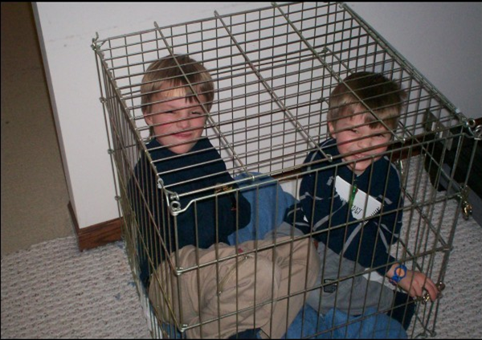
EXTINGUISH
How do we work to ensure that problem behavior is NOT being rewarded?
Possible Generic Solutions | Disruption in hall and cafeteria
Use “signal” for asking person to “stop” Teach others to ignore (turn away/look down) problem behavior | Encourage all students to work for “Friday Five” making reward for problem behavior less likely
Notes:
BARB

Slide 44
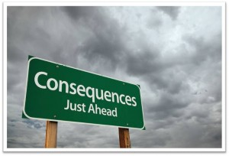
CORRECT
What are efficient, consistent consequences for problem behavior?
What are practices which support responding to problem behaviors that will reduce the likelihood of escalation?
Possible Generic Solutions | Disruption in hall and cafeteria
Intervene early by using a neutral, respectful tone of voice Label inappropriate behavior followed by what to do Follow SW discipline procedures | Active Supervision SW Response Continuum: Prompt Redirect Re-teach Provide choice Conferences
Notes:
BARB

Slide 45
SAFETY
Do we need additional safety precautions?
Possible Generic Solutions | Disruption in hall and cafeteria
Separate student from others if he/she is unable to demonstrate self-control Make sure adult supervision is available | No additional safety concerns
Notes:
BARB

Slide 46
Precise Behavior Problem Statement
  Many 3rd and 4th graders (who) are engaging in defiance (what) between 11:45 and 12:00, near the end of their 30-minute recess period (when), with most of these instances occurring on the playground and in class (where), because the students want to avoid the upcoming classroom instructional period (why).
#8
Prevent
Teach
Reinforce
Extinguish
Correct
Safety
Notes:
BARB

Slide 47
SOLUTION ELEMENTS | ACTION STEPS | GENERIC SOLUTION ACTIONS
Prevent | Focus on prevention first. How could we reduce the situations that lead to these behaviors? | Adjust physical environment Define and document expectations and routines Assure consistent and clear communication with all staff
Teach | How do we ensure that students know what they SHOULD be doing when these situations arise? | Explicit instruction linked to school-wide expectations Teach what to do, how to do it and when to do it Model respect
Reinforce | How do we ensure that appropriate behavior is recognized? | Strengthen existing school-wide rewards Include student preferences Use function-based reinforcers
Extinguish | How do we work to ensure that problem behavior is NOT being rewarded? | Use “signal” for asking person to “stop” Teach others to ignore (turn away/look down) problem behavior
Correct | How will you correct errors? | Intervene early by using a neutral, respectful tone of voice Label inappropriate behavior followed by what to do Follow SW discipline procedures
Safety | Are additional safety precautions needed? | Separate student from others if he/she is unable to demonstrate self-control Make sure adult supervision is available
Notes:
BARB

Slide 48
Identify Problem
with
Precision
Team Initiated Problem Solving Model
Make Summative
Evaluation
Decision
Identify
Goal for Change
Collect and Use Data
Monitor Impact
of Solution and
Compare
against Goal
Identify
Solution and
Create
Implementation
Plan with
Contextual Fit
Implement
Solution with
High Integrity
Horner, R. H., Newton, J. S., Todd, A. W., Algozzine, B.,
Algozzine, K., Cusumano, D. L., & Preston, A. I. (2015).
How do we know solution was implemented with fidelity?
Did we implement solution with fidelity?
Meeting
Foundations
Notes:
Barb

Slide 49
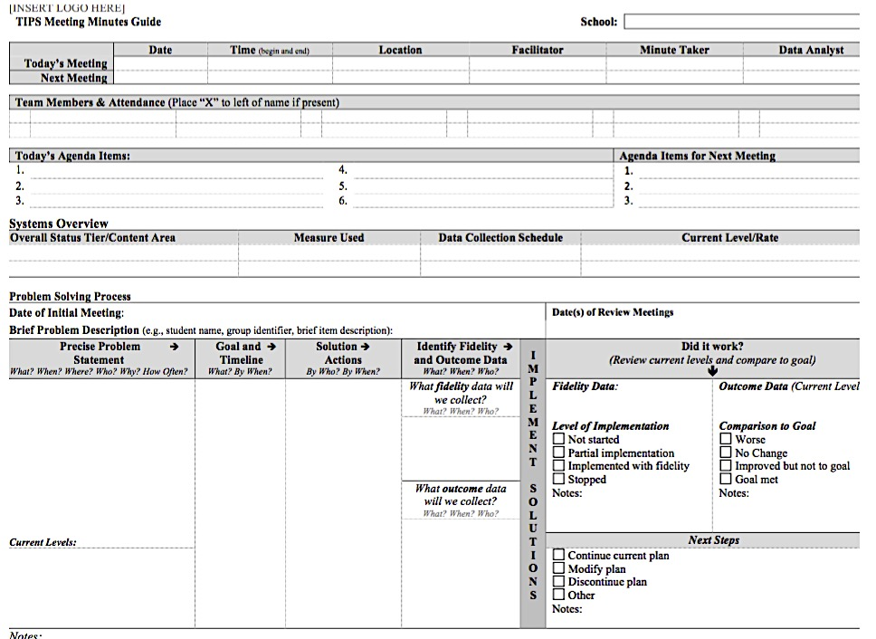
Evaluation Planning
Every problem needs to be monitored and evaluated
  How to assess the Fidelity of Implementation
Part 1
Part 1
Notes:
Barb
this stage in evaluation planning, we need two type of data to be gathered: fidelity (did we implement as planned) and outcome (did it work). These are two different types of data – emphasize this part. We will start by talking about fidelity data

Slide 50
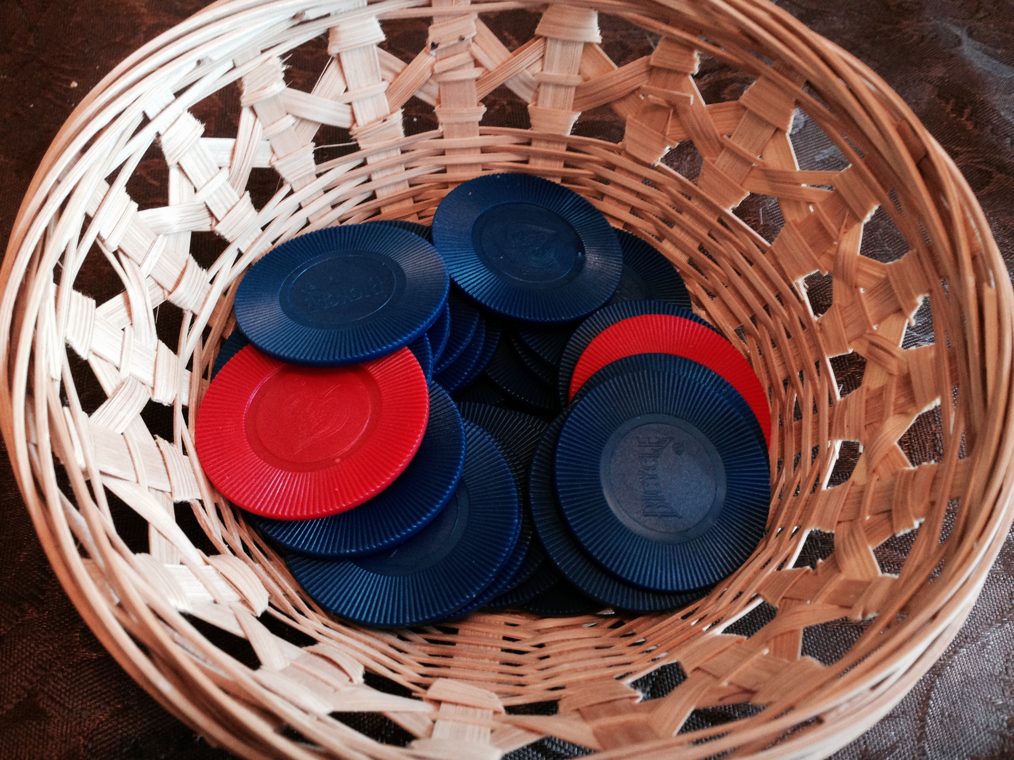
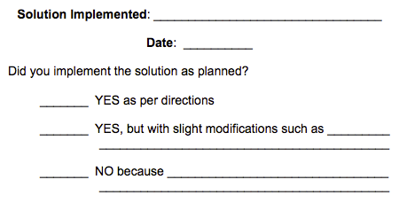
Fidelity Data
Establish a fidelity check routine that relates to Implementation
  A 1-5 scale is used for questions
  Up to 3 questions per week
  Share scale as a poster in the faculty room, an electronic survey, or paper and pencil
Did you provide “high-five greetings” to all students entering your class on time in the morning this week?
1 2 3 4 5
No Yes
Notes:
Barb

Slide 51
Evaluation Planning
Part 1
  How to assess the Fidelity of Implementation
  How to assess the Impact of Solution
Part 2
Part 2
Notes:
Barb
At this stage in evaluation planning, we need two type of data to be gathered: fidelity (did we implement as planned) and outcome (did it work). These are two different types of data – emphasize this part. We will start by talking about fidelity data

Slide 52
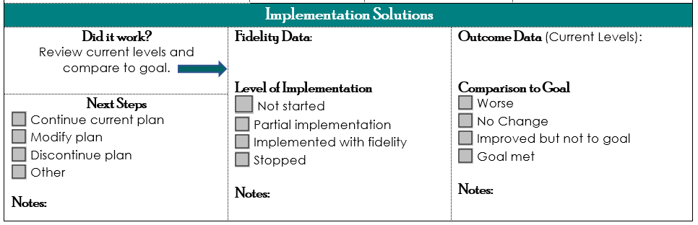
Impact & Feasibility
#9
Before determining if solution had an impact on student behavior
Ensure a high level of implementation fidelity
Measure the degree in which the intervention was implemented as defined/expected
Make easy for staff to record data
Notes:
Barb
Before determining if solution had an impact on student behavior,
ensure a high level of implementation fidelity:
How will we know solution was implemented with fidelity?
Define what, how and when to gather implementation fidelity data
Define when data will be reported
Did we implement solution with fidelity?
Use fidelity to determine the degree that solution actions were implemented as planned
Use fidelity data to revise solution actions, as needed
Measure the degree in which the intervention was implemented as defined/expected:
Use percent/absolute value/ rate/scale as metric
Strive for 80% fidelity of implementation as measured weekly (bi-weekly) on scale of 1-5
Make easy for staff to record data:
Fidelity Check Board: X on number line
Fist to five
Fidelity check basket
Direct observation

Slide 53
What
When
What
When
Where
Where
Why
Why
Who
Who
TIPS
WITH
ACADEMIC PROBELMS
Notes:
CRISTY
Often in academics, “where” and the “when” are subsumed in the “what”

Slide 54
ACADEMIC EXAMPLES
Primary to Precise
Carly is reading 20 words correctly per minute (goal is 60), skips or guesses at words she doesn’t know, mostly during language arts.
Carly can not decode and struggles to read words containing R controlled vowels, digraphs, & long vowels.
Jack’s math CBM scores fell at the 10th percentile as compared to national norms. Jack is not fluent in his knowledge of basic math facts and often does not attend to addition or subtraction signs on written math problems.
Carly is having reading difficulties.
Jack cannot add or subtract.
Notes:
CRISTY

Slide 55

ACADEMIC
Precision Statements
Three 4th grade students (Who) are not comprehending content from written text presented at grade level (What, When, and Where). These students also have weak reading fluency skills that fall well below expectation, which is thought to be the reason for their low reading comprehension skills (Why).
Current Levels: Scores on Maze measures fall below the 10th percentile on national norms (3 CR with 14 CR expected). Fluency rates also fall at or below the 10th percentile for national norms (48-53 WRC/min with 109 WRC/min expected)
Student S (Who) is having difficulty comprehending written text presented at her grade level (What, When and Where), but her reading fluency skills are in expected ranges. Weak vocabulary skills may be lowering her comprehension skills (Why).
Current Levels: Maze score = 3 CR (14 CR expected); Vocabulary level = 2nd grade on Harris Word List (4th grade expected)
Notes:
Our precision statements
CRISTY

Slide 56
Develop a Precise Problem Statement
1. Choose either
Jasmine or Paul
2. Write Precise Problem Statement using the data provided.
#10
Horner, R. H., Newton, J. S., Todd, A. W., Algozzine, B.,
Algozzine, K., Cusumano, D. L., & Preston, A. I. (2015).
Notes:
CRISTSYHand out data packets based on whether participants or teams want an academic or behavior packet

Slide 57
Possible
Precise Problem Statement
Jasmine’s reading fluency skills are well below expected targets for her grade and time of year, which is believed to be due to her weak phonics skills.
Current Levels: (Fall Benchmark)
  Phonics = 38 Sounds Correct per minute
  (goal = 68 SC/min)
  Reading Fluency = 32 Words Read Correctly per minute (goal = 82 WRC/min)
Notes:
CRISTY
Possible precise problem statement for Jasmine.

Slide 58
Possible
Precise Problem Statement
Paul is displaying disruptive behaviors (e.g., pushing pencils off the desk, walking around the room, talking to other students, calling out) during the morning reading block in his classroom in order to gain attention.
Current Levels:
  Week 1: 10.4 incidents per reading block per day
  Week 2: 11.2 incidents per reading block per day
Notes:
Cristy
Possible precise problem statement for Jasmine.

Slide 59
But wait…
…there is more!
Your student’s name is
Jasmine Paul
Notes:
Cristy
Reveal that this is not two students but one “Jasmine Paul”
Use the next slide to show how you could capture academic and behavior problems

Slide 60
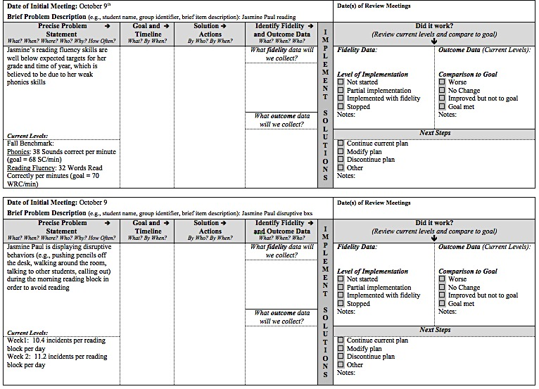
Notes:
Cristy
Two precise problems statements that may be dependent on each other

Slide 61

DATA
SCENARIOS
#11
Scenario # | Type | Level of Data | Population | Brief description
1 | Academic | Individual student | Middle or high | Middle or high school, individual student, work completion
2 | Behavior | Individual student | Elementary | On-task engagement data
3 | Behavior | Group | Middle School | Office discipline referrals
4 | Other | Group | High School | Freshman enrollment in AP classes
5 | Other | Whole School | Elementary | Attendance at Open House
6 | Behavior | Individual student | Elementary or Middle | Data monitoring disruptive behaviors
7 | Other | District | District | Consensus data regarding MTSS implementation
8 | Academic | Individual | High School | Math/Science grades
Notes:
Cristy

Slide 62
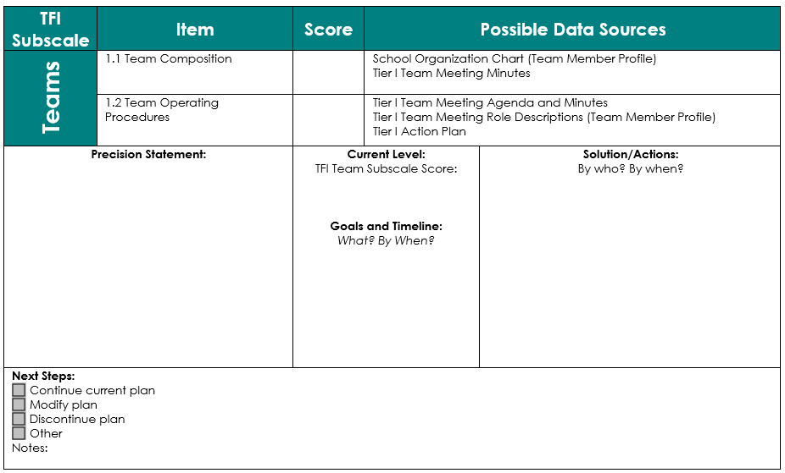
Tiered Fidelity Inventory
#12
Notes:
BARB

Slide 63
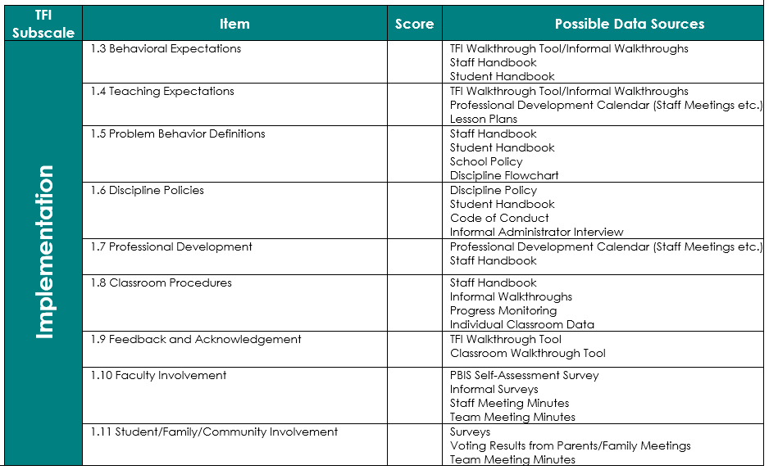
Notes:
Barb

Slide 64
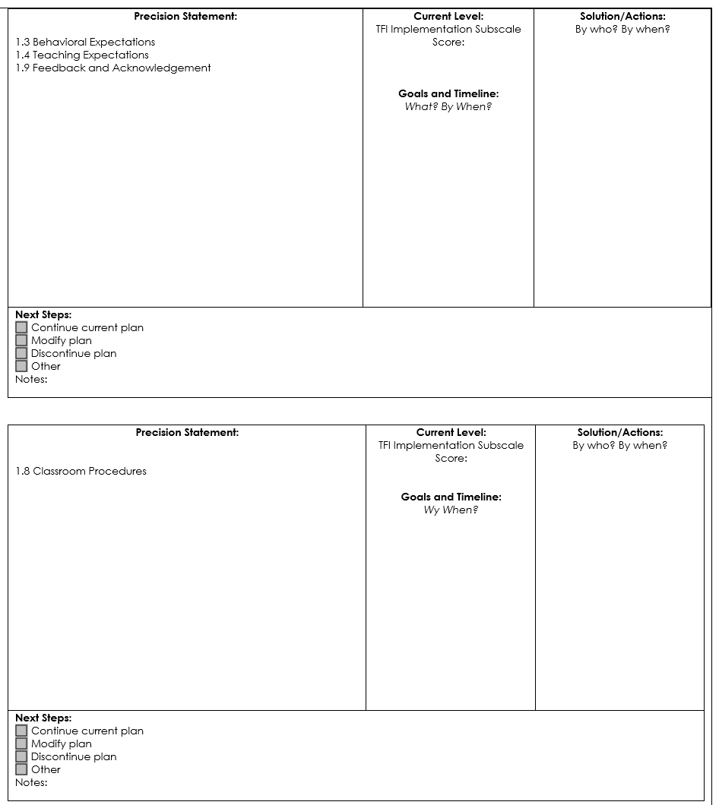
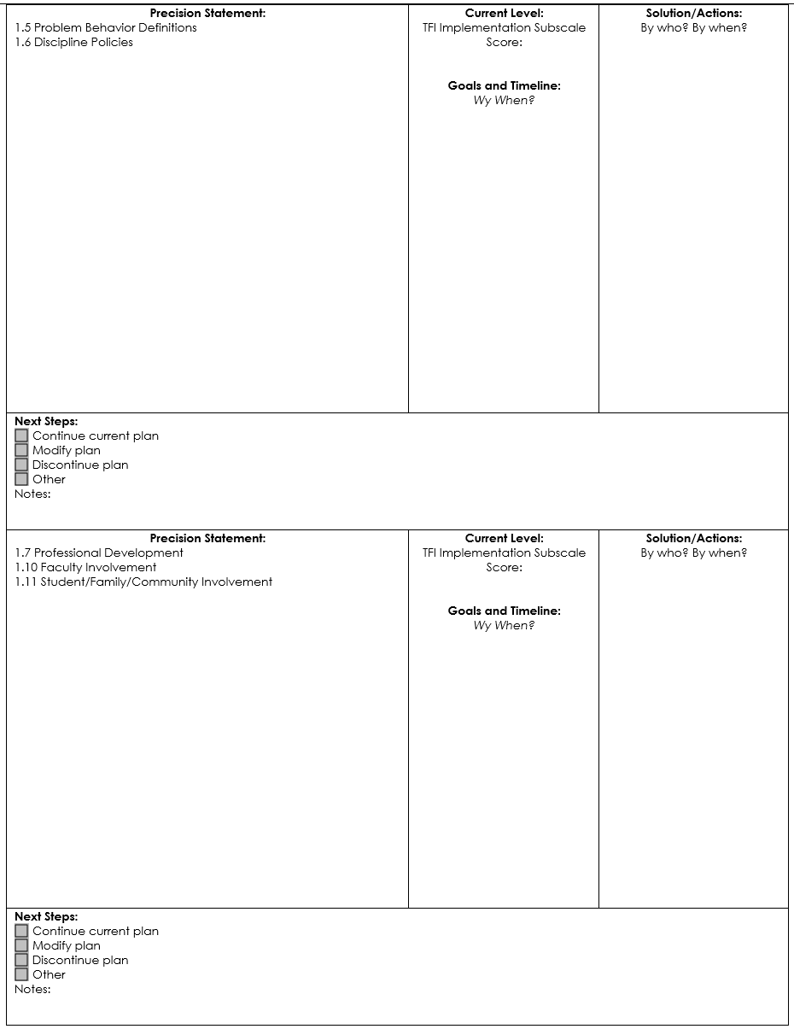
1.3 Behavioral Expectations
1.4 Teaching Expectations
1.9 Feedback and Acknowledgement
1.5 Problem Behavior Definitions
1.6 Discipline Policies
1.6 Classroom Procedures
1.7 Professional Development
1.10 Faculty Involvement
1.11 Student/Family/Community Involvement
Notes:
Barb

Slide 65
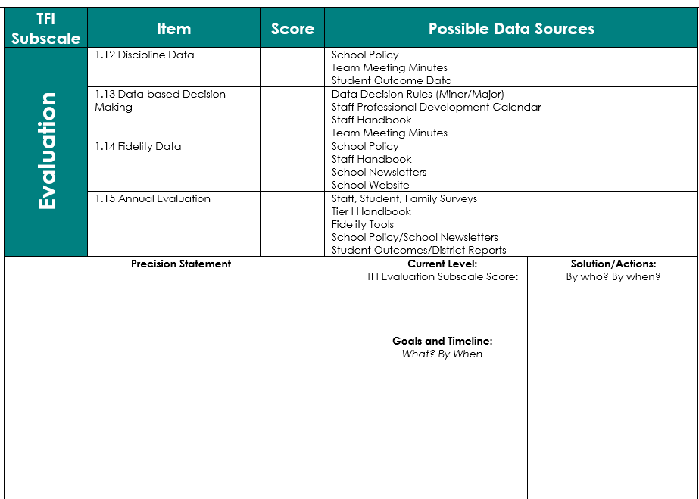
Notes:
Barb

Slide 66

#13
DISTRICT READINESS
Checklist
District Commitment
Commitment to work with SCHOOL Teams
Access to Data
Notes:
Barb

Slide 67


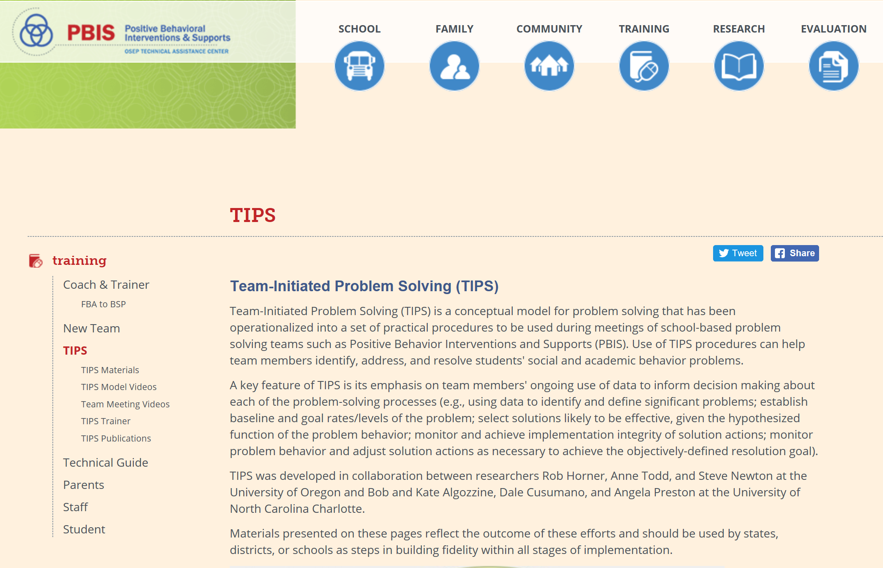
Cristy Clouse cristy@pbiscaltac.org
Barbara Kelley barbara@pbiscaltac.org
https://www.pbis.org/training/tips
Notes:
Cristy
https://www.pbis.org/training/tips

